Slide 1

Turing Machines
Chapter 17

Slide 2
Languages and Machines
SD
D
Context-Free
Languages
Regular
Languages
reg exps
FSMs
cfgs
PDAs
unrestricted grammars
Turing Machines

Slide 3
Grammars, SD Languages, and Turing Machines
L
SD Language
Unrestricted Grammar
Accepts
Turing Machine

Slide 4
Turing Machines
  Can we come up with a new kind of automaton that has two properties:
  ● powerful enough to describe all computable things
  unlike FSMs and PDAs.
  ● simple enough that we can reason formally about it
  like FSMs and PDAs,
  unlike real computers.

Slide 5
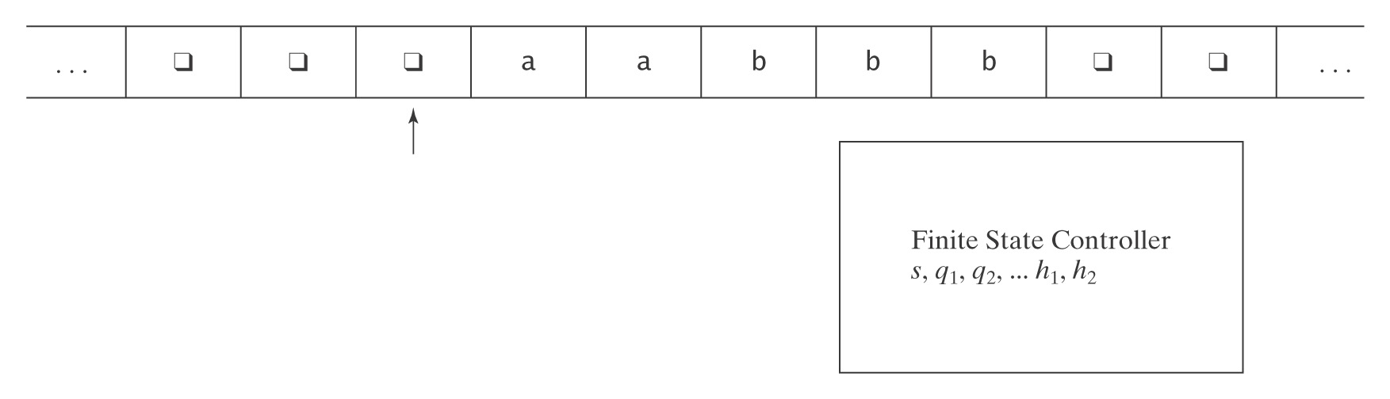
Turing Machines
  At each step, the machine must:
  ● choose its next state,
  ● write on the current square, and
  ● move left or right.

Slide 6
A Formal Definition
A Turing machine M is a sixtuple (K, Σ, Γ, δ, s, H):
● K is a finite set of states;
● Σ is the input alphabet, which does not contain ;
● Γ is the tape alphabet, which must contain  and have Σ as a
subset.
● s ∈ K is the initial state;
● H ⊆ K is the set of halting states;
● δ is the transition function:
(K - H) × Γ to K × Γ × {→, ←}
non-halting × tape state × tape × action
state char char (R or L)

Slide 7
Notes on the Definition
1. The input tape is infinite in both directions.
2. δ is a function, not a relation. So this is a definition for
deterministic Turing machines.
3. δ must be defined for all (state, input) pairs unless the state is a halting state.
4. Turing machines do not necessarily halt (unlike FSM's and
PDAs). Why? To halt, they must enter a halting state.
Otherwise they loop.
5. Turing machines generate output so they can compute
functions.

Slide 8
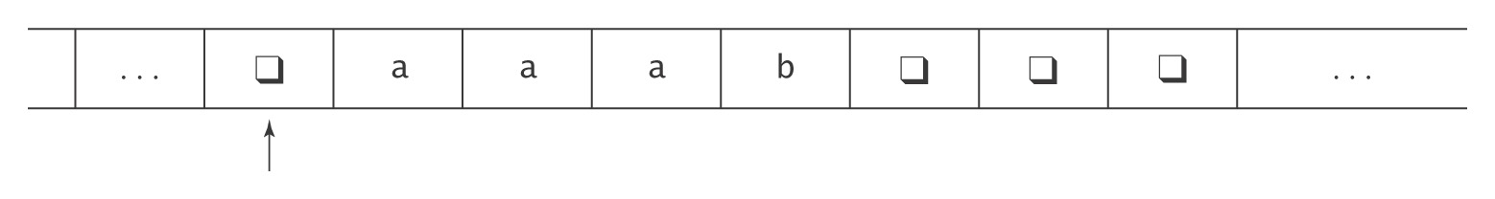
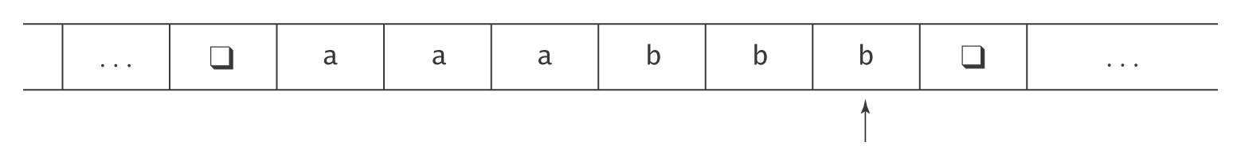
An Example
M takes as input a string in the language:
{a^{i}b^{j}, 0 ≤ j ≤ i},
and adds b’s as required to make the number of b’s equal the number of a’s.
The input to M will look like this:
The output should be:

Slide 9
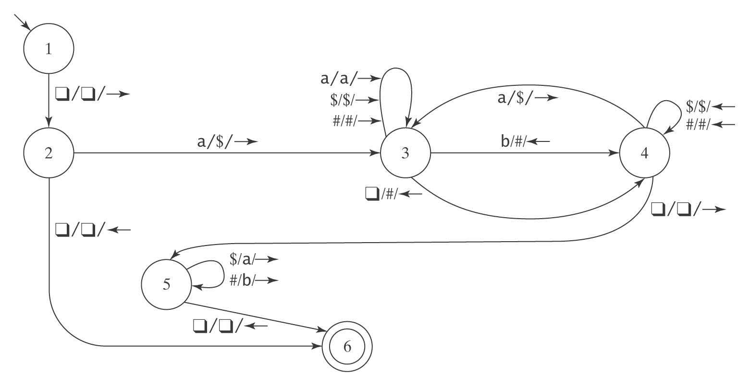
The Details
K = {1, 2, 3, 4, 5, 6}, Σ = {a, b}, Γ = {a, b, , $, #},
s = 1, H = {6}, δ =

Slide 10
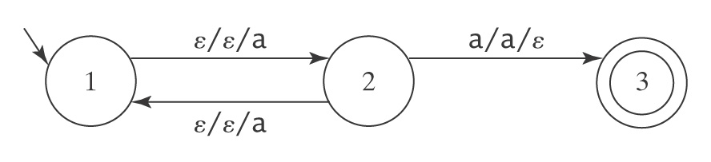
Halting
● A DFSM M, on input w, is guaranteed to halt in |w| steps.
● A PDA M, on input w, is not guaranteed to halt. To see
why, consider again M =
But there exists an algorithm to construct an equivalent PDA
M′ that is guaranteed to halt.
A TM M, on input w, is not guaranteed to halt. And there exists no algorithm to construct one that is guaranteed to do so.

Slide 11
Formalizing the Operation
A configuration of a Turing machine
M = (K, Σ, Γ, s, H) is an element of:
K × ((Γ- {}) Γ*) ∪ {ε} × Γ × (Γ* (Γ- {})) ∪ {ε}
state up scanned after
to scanned square scanned
square square

Slide 12
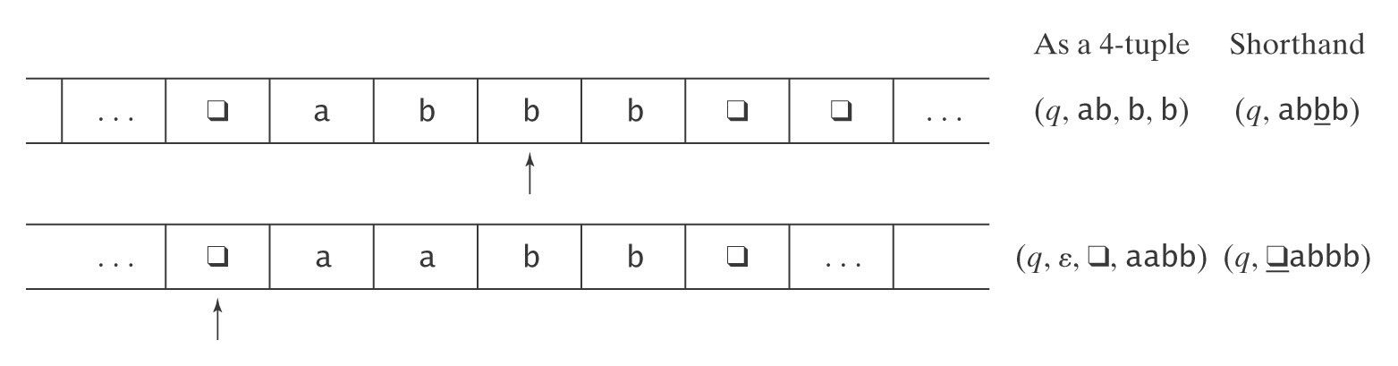
Example Configurations
(1) (q, ab, b, b) = (q, abbb)
(2) (q, ε, , aabb) = (q, aabb)
Initial configuration is (s, w).

Slide 13
Yields
(q₁, w₁) |-_{M} (q₂, w₂) iff (q₂, w₂) is derivable, via δ, in one step.
For any TM M, let |-_{M}* be the reflexive, transitive closure of |-_{M}.
Configuration C₁ yields configuration C₂ if: C₁ |-_{M}* C₂.
A path through M is a sequence of configurations C₀, C₁, …, C_{n} for some n ≥ 0 such that C₀ is the initial configuration and:
C₀ |-_{M} C₁ |-_{M} C₂ |-_{M} … |-_{M} C_{n}.
A computation by M is a path that halts.
If a computation is of length n or has n steps, we write:
C₀ |-_{M}^{n} C_{n}

Slide 14
A Notation for Turing Machines
(1) Define some basic machines
● Symbol writing machines
For each x ∈ Γ, define M_{x}, written just x, to be a machine that writes x, then halts.
● Head moving machines
R: for each x ∈ Γ, δ(s, x) = (s, x, →)
L: for each x ∈ Γ, δ(s, x) = (s, x, ←)
● Machines that simply halt:
h, which simply halts.
n, which halts and rejects.
y, which halts and accepts.

Slide 15
Checking Inputs and Combining Machines
Next we need to describe how to:
● Check the tape and branch based on what character
we see, and
● Combine the basic machines to form larger ones.
To do this, we need two forms:
● M₁M₂
  Begin in start state of M₁, run M₁ until halts, begin M₂ in start state, run M₂ until halts, then halt. If either fails to halt, then M₁M₂ fails to halt.
● M₁ M₂
  The same, except that <condition> is checked to move from M₁ to M₂.
  <condition>

Slide 16
A Notation for Turing Machines, Cont'd
Example:
>M₁ a M₂
b
M₃
● Start in the start state of M₁. (“>” marks the beginning)
● Compute until M₁ reaches a halt state.
● Examine the tape and take the appropriate transition.
● Start in the start state of the next machine, etc.
● Halt if any component reaches a halt state and has no place
to go.
● If any component fails to halt, then the entire machine may fail to halt.

Slide 17
Shorthands
a
M₁ M₂ becomes M₁ a, b M₂
b
M₁ all elems of Γ M₂ becomes M₁ M₂
or
M₁M₂
Variables
M₁ all elems of Γ M₂ becomes M₁ x ← ¬a M₂
except a and x takes on the value of
the current square
M₁ a, b M₂ becomes M₁ x ← a, b M₂
and x takes on the value of
the current square
M₁ x = y M₂
if x = y then take the transition
e.g., > x ← ¬ Rx if the current square is not blank, go right and copy it.

Slide 18
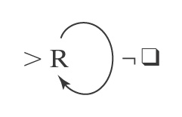
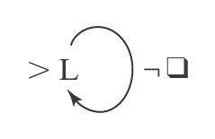
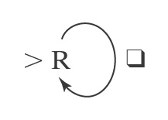
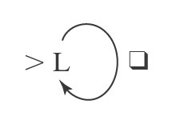
Some Useful Machines
Find the first blank square to
the right of the current square.
Find the first blank square to
the left of the current square.
Find the first nonblank square to
the right of the current square.
Find the first nonblank square to
the left of the current square
R
L
R¬
L¬

Slide 19
More Useful Machines
L_{a} Find the first occurrence of a to
the left of the current square.
R_{a,b} Find the first occurrence of a or b
to the right of the current square.
L_{a,b} a M₁ Find the first occurrence of a or b
to the left of the current square,
b then go to M₁ if the detected
character is a; go to M₂ if the
M₂ detected character is b.
L_{x←a,b} Find the first occurrence of a or b
to the left of the current square
and set x to the value found.
L_{x←a,b}Rx Find the first occurrence of a or b
to the left of the current square,
set x to the value found, move one
square to the right, and write x (a or b).

Slide 20
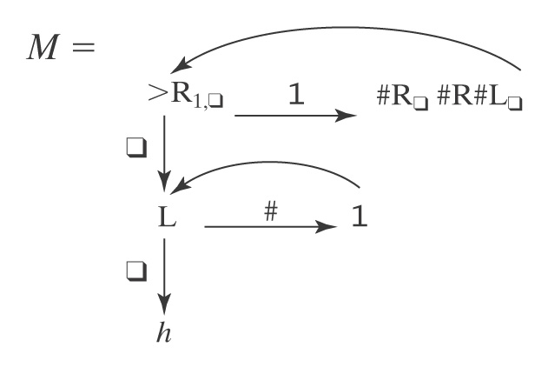
An Example
Input: w w ∈ {1}*
Output: w³
Example: 111

Slide 21
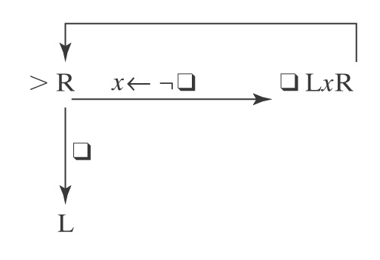
A Shifting Machine S←
Input: uw
Output: uw
Example: baabba

Slide 22
Turing Machines as Language Recognizers
Convention: We will write the input on the tape as:
w, w contains no ’s
The initial configuration of M will then be:
(s, w)
Let M = (K, Σ, Γ, δ, s, {y, n}).
● M accepts a string w iff (s, w) |-_{M}* (y, w′) for some string w′.
● M rejects a string w iff (s, w) |-_{M}* (n, w′) for some string w′.

Slide 23
Turing Machines as Language Recognizers
M decides a language L ⊆ Σ* iff:
For any string w ∈ Σ* it is true that:
if w ∈ L then M accepts w, and
if w ∉ L then M rejects w.
A language L is decidable iff there is a Turing machine M that decides it. In this case, we will say that L is in D.

Slide 24
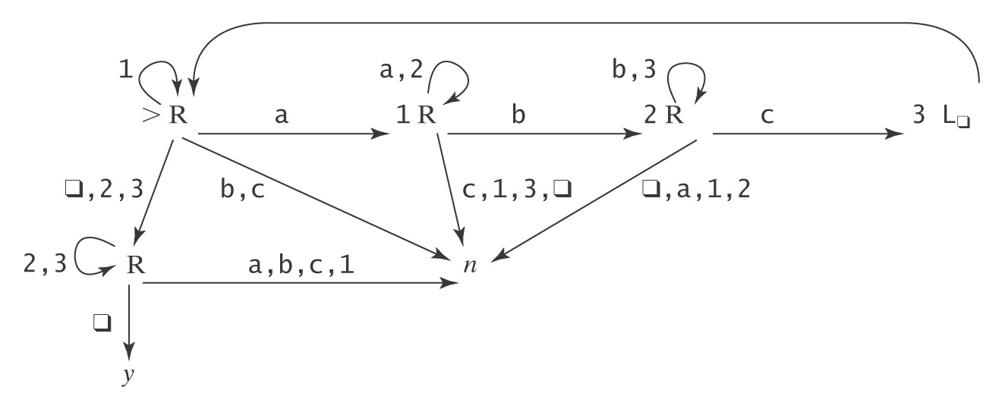
A Deciding Example
A^{n}B^{n}C^{n} = {a^{n}b^{n}c^{n} : n ≥ 0}
Example: aabbcc
Example: aaccb

Slide 25
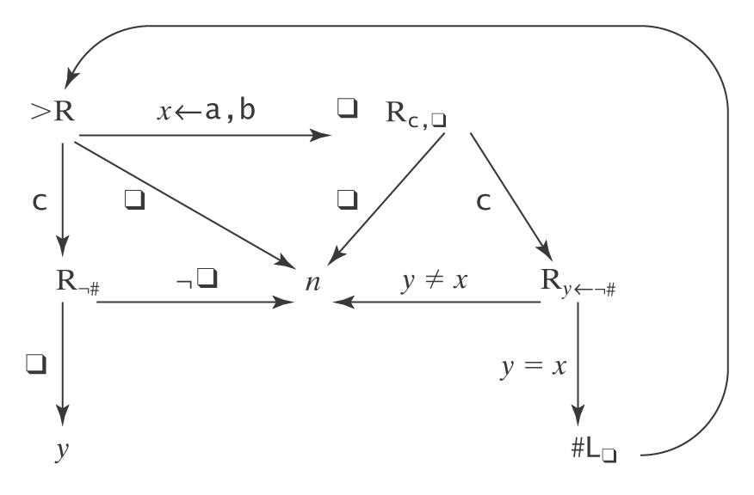
Another Deciding Example
WcW = {wcw : w ∈ {a, b}*}
Example: abbcabb 
Example: acabb

Slide 26
Semideciding a Language
Let Σ_{M} be the input alphabet to a TM M. Let L ⊆ Σ_{M}*.
M semidecides L iff, for any string w ∈ Σ_{M}*:
● w ∈ L → M accepts w
● w ∉ L → M does not accept w. M may either:
reject or
fail to halt.
A language L is semidecidable iff there is a Turing machine that semidecides it. We define the set SD to be the set of all semidecidable languages.

Slide 27
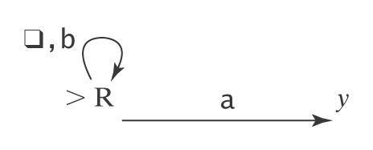
Example of Semideciding
Let L = b*a(a ∪ b)*
We can build M to semidecide L:
1. Loop
  1.1 Move one square to the right. If the character under
  the read head is an a, halt and accept.
In our macro language, M is:

Slide 28
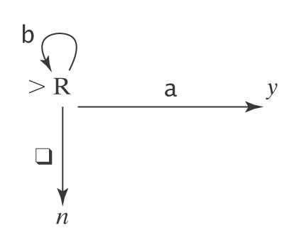
Example of Semideciding
L = b*a(a ∪ b)*. We can also decide L:
  Loop:
    1.1 Move one square to the right.
    1.2 If the character under the read/write head is
    an a, halt and accept.
    1.3 If it is , halt and reject.
In our macro language, M is:

Slide 29
Computing Functions
Let M = (K, Σ, Γ, δ, s, {h}). Its initial configuration is (s, w).
Define M(w) = z iff (s, w) |-_{M}* (h, z).
Let Σ′ ⊆ Σ be M’s output alphabet (i.e., the set of symbols that M may leave on its tape when it halts)
Let f be any function from Σ* to Σ′*.
M computes f iff for all w ∈ Σ*, M(w) = f(w).
A function f is recursive or computable iff there is a Turing machine M that computes it.
(Note that M always halts.)

Slide 30
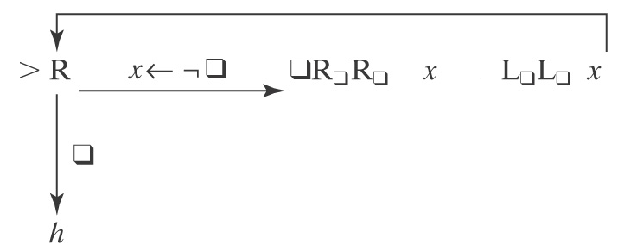
Example of Computing a Function
Let Σ = {a, b}. Let f(w) = ww.
Input: w Output: ww
Define the copy machine C:
w → ww
Remember the S← machine:
uw → uw
Then the machine to compute f is just >C S← L

Slide 31
Computing Numeric Functions
For any positive integer k, value_{k}(n) returns the nonnegative integer that is encoded, base k, by the string n.
For example:
● value₂(101) = 5.
● value₈(101) = 65.
TM M computes a function f from ℕ^{m} to ℕ iff, for some k:
value_{k}(M(n₁;n₂;…n_{m})) = f(value_{k}(n₁), … value_{k}(n_{m})).

Slide 32
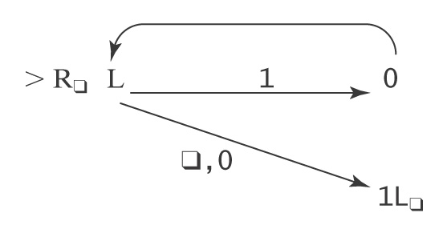
Computing Numeric Functions
Example: succ(n) = n + 1
We will represent n in binary. So n ∈ 0 ∪ 1{0, 1}*
Input: n Output: n+1
1111 Output: 10000

Slide 33
Not All Functions Are Computable
Let T be the set of all TMs that:
● Have tape alphabet Γ = {, 1}, and
● Halt on a blank tape.
Define the busy beaver functions S(n) and Σ(n):
● S(n): the maximum number of steps that are executed by any element of
T with n-nonhalting states, when started on a blank tape, before it halts.
● Σ(n): the maximum number of 1’s left on the tape by any element
of T with n-nonhalting states, when it halts.
n | S(n) | Σ(n)
1 | 1 | 1
2 | 6 | 4
3 | 21 | 6
4 | 107 | 13
5 | ≥ 47,176,870 | 4098
6 | ≥ 3⋅10¹⁷³⁰ | ≥ 1.29⋅10⁸⁶⁵

Slide 34
Why Are We Working with Our Hands Tied Behind Our Backs?
Turing machines Are more powerful than any of
the other formalisms we have
studied so far. ☺
Turing machines Are a lot harder to work with than
all the real computers we have
available.
☹
Why bother?
The very simplicity that makes it hard to program Turing machines makes it possible to reason formally about what they can do. If we can, once, show that anything a real computer can do can be done (albeit clumsily) on a Turing machine, then we have a way to reason about what real computers can do.

